Slide 1
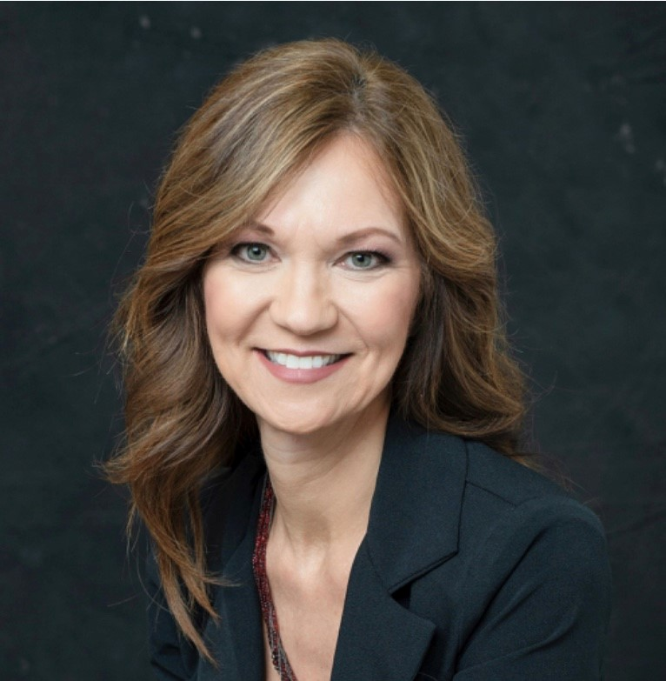
FACEBOOK
Accessing Humana Approved Ads
Michelle Cook
Sales & Marketing Support Executive
Arkansas / Oklahoma
417-430-7769
mcook25@humana.com

Slide 2
REMINDERS:
Set up a Facebook Business Page (must have a personal page first)
Complete the Humana required social media training in Vantage
  www.humana.com
  Sign in with user name / password
  Go to the Education card
  Select “MRC – Social Media Pilot” training
Wait for the Social Media icon to be added to your MRC page (48-72 hrs)
Version & load a Humana approved social media ad to your business Facebook page
NOW --- you are ready to boost an ad!!

Slide 3
What is Boosting?
Boosted posts are paid ads you can create from posts on a Facebook Business Page.
By boosting a post, your post will be seen by people who do not follow your page.
It allows you an opportunity to reach new people who may be interested in the information on your page.
There is a fee from Facebook associated with boosted ads since they are publishing your ad to a wider audience.
By boosting an ad you have created using Humana’s Marketing Resource Center, you efficiently make your name and contact information available to many people.

Slide 4
Boosting Compliantly
Below are some highlights from Humana’s policy on social media. Be sure to review the policy for full details.
Agents must follow Medicare Communication & Marketing Guidelines & may not discriminate based on race, ethnicity, national origin, religion, gender, sex, age, mental or physical disability, health status, receipt of health care, claims experience, medical history, genetic information, evidence of insurability, or geographic location.
In order to comply with HIPAA regulations, agents may never provide a list of Medicare members or prospects to Facebook.
Agents may only boost posts on Facebook that comply with all applicable laws & regulations, including HIPAA, the MCMG & Humana’s policy & procedures.
Agents may only target ads in locations in which they are licensed, appointed & certified to sell Humana plans.
Agents can target ads to individuals who may be eligible for Medicare. To do this you can set the target audience by selecting “Medicare” or “Medicare Advantage” as an interest in the demographic section. The MCMG prohibits targeting potential enrollees from higher income areas, or stating or implying that plans are only available to seniors rather than to all Medicare beneficiaries or stating or implying that plans are only available to Medicaid beneficiaries unless the plan is a D-SNP or MMP.

Slide 5
Boosting Compliantly continued…
Agents can use income ranges to target specific consumers based on campaign design. For example, $0 premium ads might resonate better with a lower income population. The MCMG prohibits targeting potential enrollees from higher income areas.
Agents may use income ranges to target dual eligible consumers when marketing DSNP plans. Please Note! Agents may not use income levels to target Value Plus Plans. The MCMG prohibits plans that are not D-SNPs to imply that their plan is designed for dual-eligible individuals or targeting their marketing efforts exclusively to dual eligible individuals.
Ads designed to reach multicultural demographics can target those populations.
Medicare ads should not be targeted to consumers in any way based on health status, unless you are targeting ads based on eligibility requirements. For example, agents should not select healthy lifestyle options when selecting target demographics.
Agents will be required to provide evidence of complying with these rules & Sales Integrity / Humana’s Compliancy conduct monitoring & auditing to confirm compliance.

Slide 6
Update your MRC Profile for Facebook
In order for Facebook Boosted Posts to function correctly for Humana-approved
ads, you need to enter a URL into your MRC profile.
When a consumer clicks on your boosted post, they will be directed to the URL you enter.
A best practice is to enter your Facebook Business Page URL.
Partner Agents may choose to enter your Facebook URL or another website that you own (such as your business or agency website).
The following slides will walk you thru that process on how to load your URL.

Slide 7
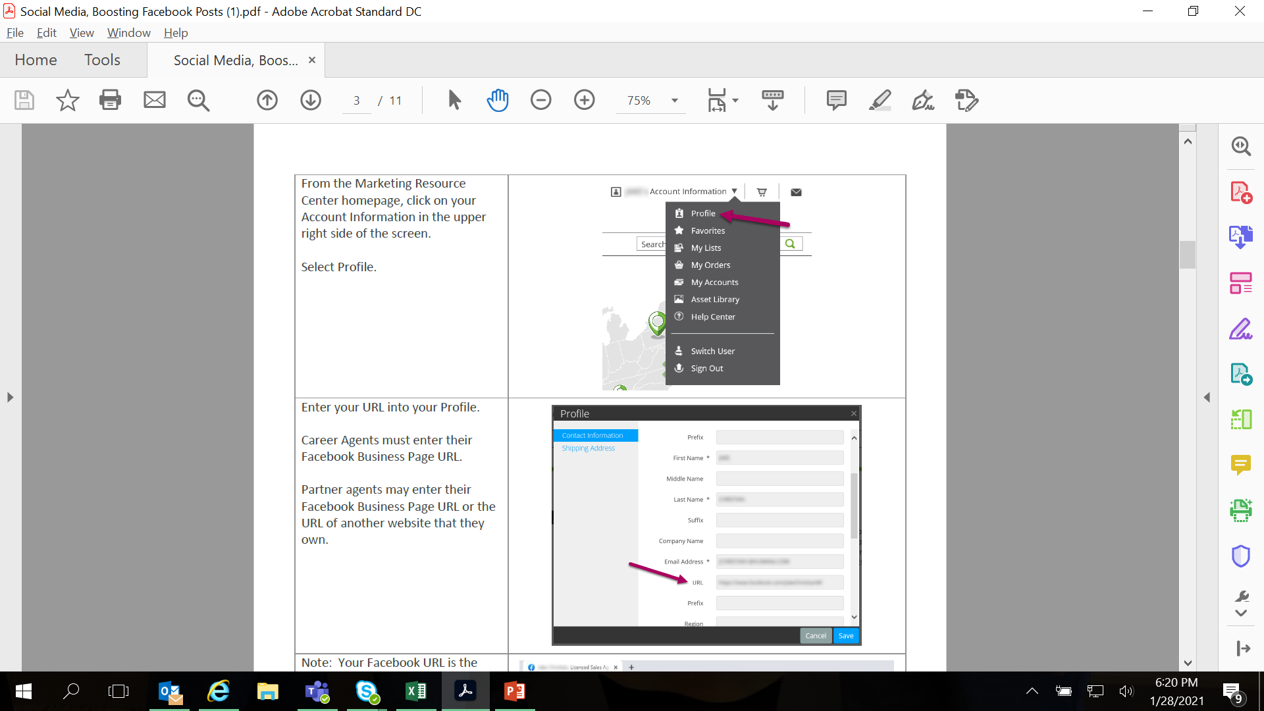

Slide 8
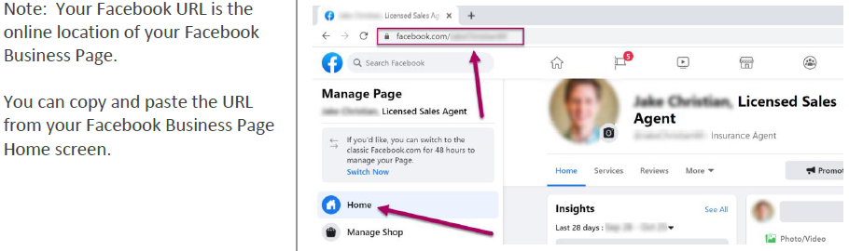
If using your business or agency URL –
Your business or agency URL will be in the browser bar of your website. Simply right click on that data, copy and then paste that information into the URL field in your MRC Profile so the information will link and you can boost.

Slide 9
NOW Let’s Boost!
From your Facebook business page, click on the blue button “Boost Post”
*If boosting for the first time, you must read & accept Facebook’s non-discrimination policy.
You will then see a screen where you will set up the specifics of who you wish to reach with your ad.
Audience
Age Range
Location (be realistic & targeted)
You may also use “Detailed Targeting”
Demographics
Interests
Behaviors

Slide 10
Determine the budget and the duration of how long you want your ad to be boosted.
*Facebook suggest a minimum of 4 days.
The minimum amount per day is $1.
The higher the budget, the more people you will reach with that ad.
It’s best to start with a small budget to see how your ad will perform. You can always ad to the budget/duration later.
NOTE: You can only book Humana ads on Facebook. By default the Messenger & Instagram button may be checked. Be sure to uncheck these.

Slide 11
Add your payment information.
*Facebook will sometimes offer you
specials bonuses such as:
“Free $20 in boosting credits with any $20 boosted ad” purchase.”
Once you have your payment information set up, simply click “Boost Post Now”.
You will receive a notification that your ad has been submitted for review. They will notify you 24 hours (or less) if it meets the advertising policies and then post.

Slide 12
You can check the status of your
ad in review by going to the
Ad Center in menu under “Manage
Page” on the left hand side
of your Facebook page.
You can also utilize the Ad Center
to check how your ad is performing for you. You can see:
Number of people reached
Post Engagements (number of likes or comments)
Budget you have spent to date
*This is also where you can increase your budget spend or duration of ad time if needed

Slide 13
Questions??

